Slide 1

Power BI Introduction
Created By: Data Engineering Team
Create Date: June 2024

Slide 2
Agenda
How to Navigate the Power BI Portal
Home Page
Workspaces
How to Navigate within a Power BI Dashboard
Action Bar
Pages Panel
Filters Panel
Page Features

Slide 3

How to Navigate the Power BI Portal - Home Page

Slide 4

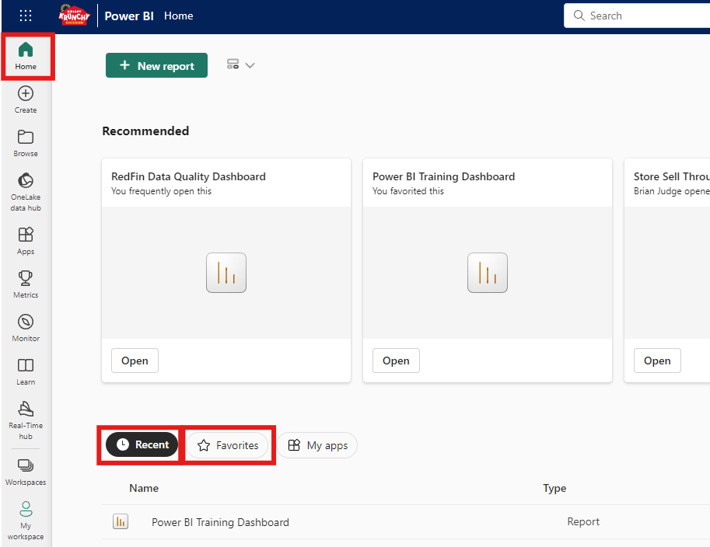
Home Page
Home Page Definition: The Home Page is the landing page when you log into the Power BI portal. This is where you can view recent Power BI dashboards that you have viewed previously, as well as navigate to the Workspaces that you have access to
Home Page Features:
Recent
Favorites

Slide 5
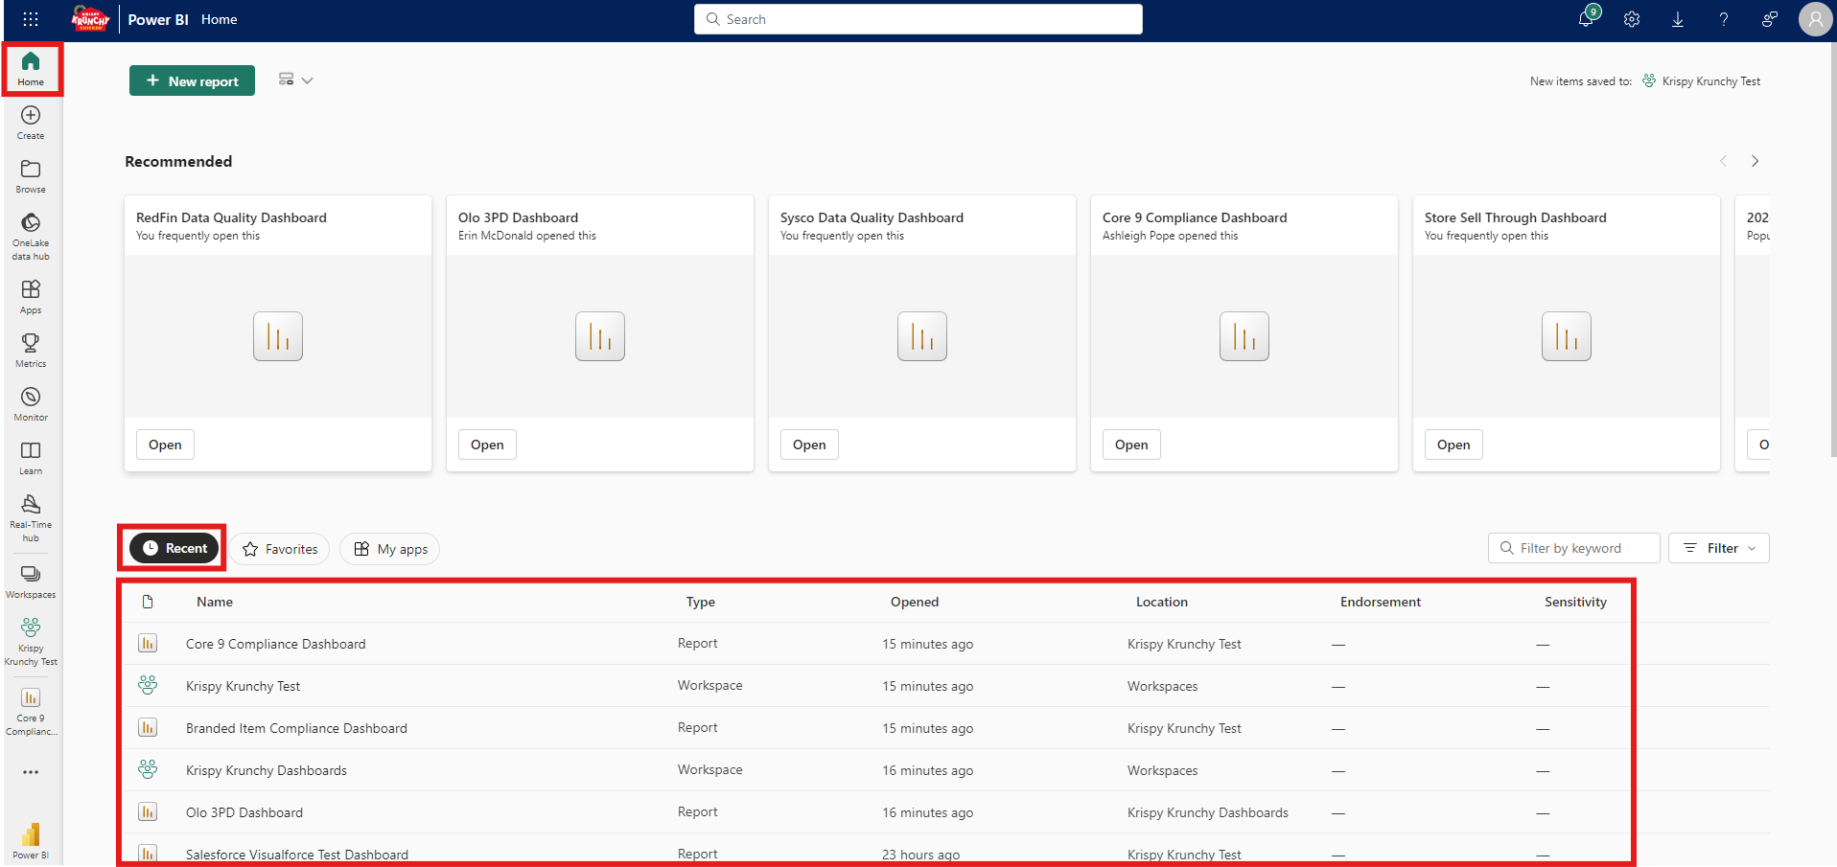
Home Page - Recent
Recent - Displays a list of dashboards that the user recently viewed

Slide 6
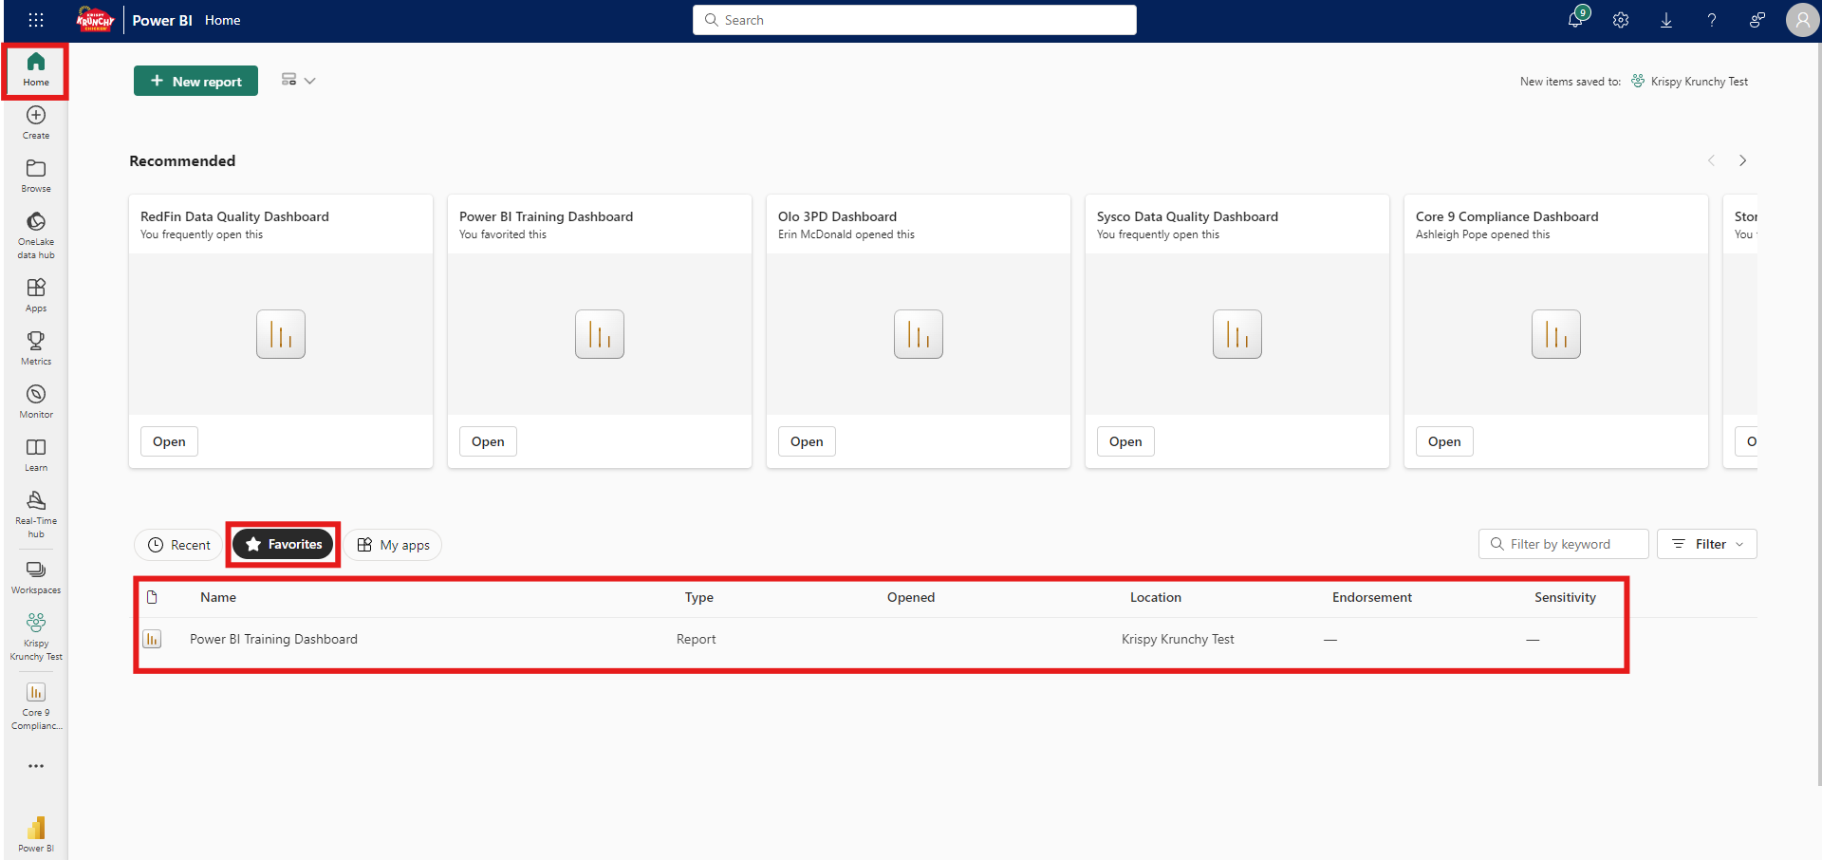
Home Page - Favorites
Favorites - Displays a list of dashboards that the user marked as their favorite

Slide 7
How to Navigate the Power BI Portal - Workspaces

Slide 8
Workspaces
Workspace Definition – Collections of Power BI dashboards, think of workspaces as folders
Data Quality - Contains dashboards that showcase all of the data that we have collected within our data warehouse for reporting purposes based on the source of the data
Krispy Krunchy Dashboards - Contains dashboards that are live / in production that are ready for use
Krispy Krunchy Test - Contains dashboards that are in UAT (user acceptance testing). When a dashboard within this workspace is approved by the dashboard owner, it will be moved to the Krispy Krunchy Dashboard workspace

Slide 9
How to Navigate within a Power BI Dashboard - Action Bar

Slide 10
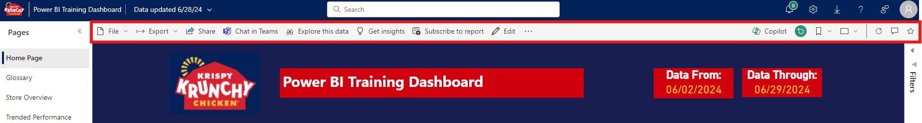
Action Bar
Action Bar Definition: Contains features that users can use to export, share, comment and more
Action Bar Features:
Export
Share
Chat In Teams
Refresh Filters
Bookmarks
Refresh
Comment
Favorite

Slide 11
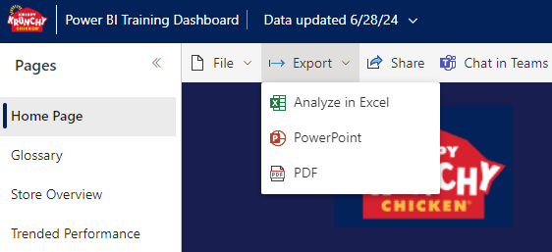
Action Bar - Export
Export - Allows user to export the entire dashboard or just the current page being displayed. Can export to:
Excel
PowerPoint
PDF

Slide 12
Action Bar – Export: Excel
Excel – Exports all the data within the Power BI dashboard into Excel. The data can then be used in Excel to build reports
Video Removed To Reduce Overall File Size

Slide 13
Action Bar – Export: PowerPoint
PowerPoint – Exports the Power BI dashboard into PowerPoint
Embed live data – Exports the Power BI dashboard into an interactive PowerPoint.
Export as image – Exports each page within the Power BI dashboard into a PowerPoint page
Current Values – Exports the data with the current filter / slicer selection(s)
Default Values – Exports the data with the no filter / slicer selections
Video Removed To Reduce Overall File Size

Slide 14
Action Bar – Export: PDF
PDF – Exports the Power BI dashboard into a PDF
Current Values – Exports the data with the current filter / slicer selection(s)
Default Values – Exports the data with the no filter / slicer selections
Video Removed To Reduce Overall File Size

Slide 15
Action Bar - Share
Share - Allows user to share the dashboard:
Link - Allows the user to copy and send a link to the dashboard based on their sending preference
Email - Allows the user to send an email to someone that will direct the new user to the dashboard within Power BI
Chat in Teams - Allows the user to send a Teams chat to someone that will direct the new user to the dashboard within Power BI
Power Point - Allows the user to copy and send a PDF version of the dashboard based on their sending preference
Video Removed To Reduce Overall File Size

Slide 16
Action Bar – Chat In Teams
Chat In Teams - Another away for the user to be able to share the dashboard via Teams
Video Removed To Reduce Overall File Size

Slide 17
Action Bar – Refresh Filters
Refresh Filters - Only appears if the user has made filter selections, different from the default filters, within the dashboard
Video Removed To Reduce Overall File Size

Slide 18
Action Bar - Bookmarks
Bookmarks - Allows the user to open the Bookmark panel, located on the right side of the screen
Personal - Allows users to add their own bookmarks, which is a collection of filters made by the user
Report - These are bookmarks made by the developers on the dashboard. Users can use these bookmarks from the bookmarks panel
Each of these bookmarks are tied to interactive buttons found within the dashboard
Video Removed To Reduce Overall File Size

Slide 19
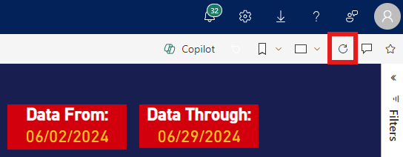
Action Bar - Refresh
Refresh - Allows the user to refresh the dashboard at any time to ensure that the data being displayed is up to date
If the user has a Power BI dashboard open in a browser tab when the dashboard is being updated, the user will not see the updated data
The user will have to either:
Close and reopen the dashboard
Refresh the browser page
Click the refresh button located on the right side in the action bar

Slide 20
Action Bar - Comment
Comment - Allows the user to post comments on the dashboard so that other users can see
@mentions can be used to tag certain other users and notify them of your comment(s)
Video Removed To Reduce Overall File Size

Slide 21
Action Bar - Favorite
Favorite - Allows the user to favorite the dashboard, making it appear in the user's Favorites section on the Power BI home page
Video Removed To Reduce Overall File Size

Slide 22
How to Navigate within a Power BI Dashboard - Pages Panel

Slide 23
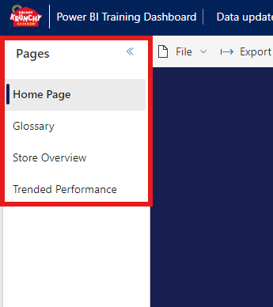
Pages Panel
Pages Panel Definition: Displays all the pages that make up the dashboard. This is where users will navigate between each page within the dashboard
Pages Panel Features:
Home Page
Glossary
Additional Pages

Slide 24
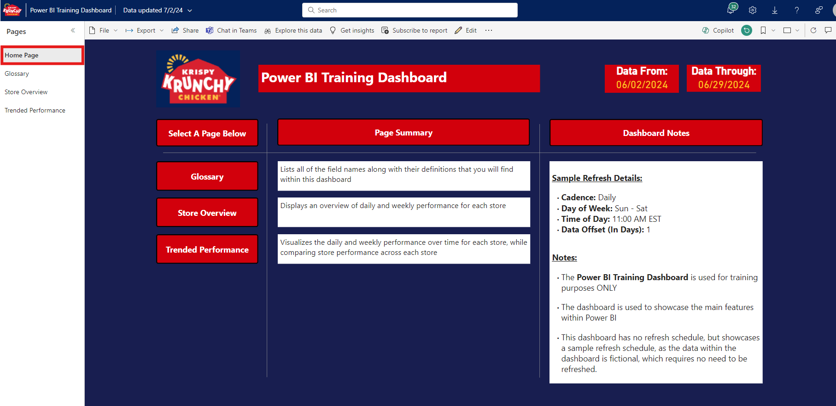
Pages Panel – Home Page
Home Page – Each dashboard will have a Home Page, which displays the:
Dashboard Title – Displays the title of the Power BI dashboard
Dashboard Metric(s) – This could be store counts or product counts within the dashboard, as well as dates that are being included within the dashboard
Select a Page Below (Interactive Buttons) – for each page that the user can use to navigate to the page of their choosing
Page Summary – Informs the user on what data and insights they will see within each page
Dashboard Notes – informs the user on the refresh schedule of the dashboard, as well as any other important notes pertaining to the dashboard

Slide 25
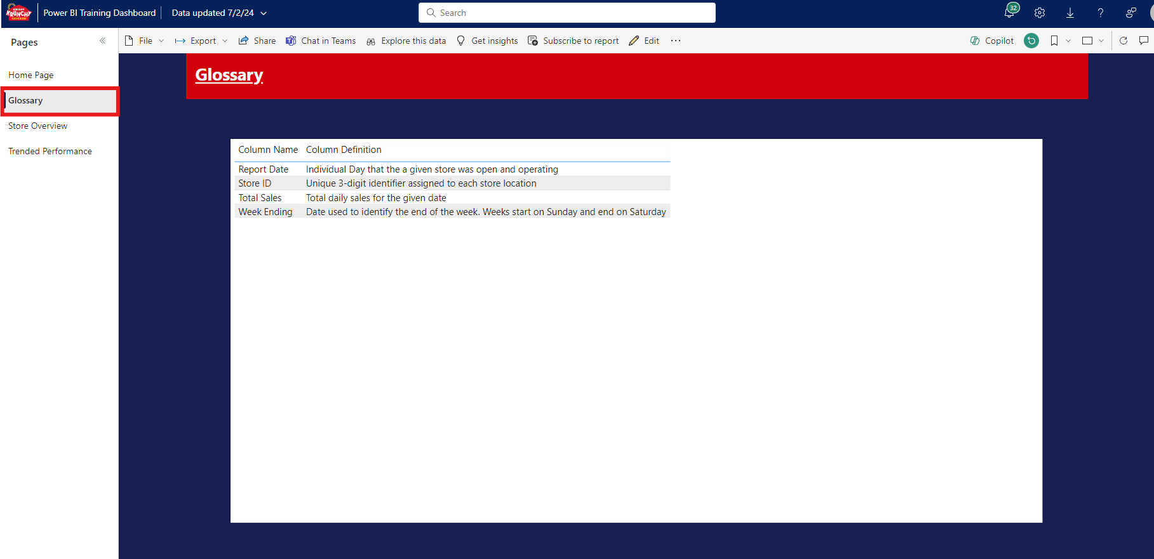
Pages Panel - Glossary
Glossary – Each dashboard will have a Glossary page, which displays a table containing all of the fields (Columns) that the user may see within the dashboard, along with definitions for each field and any formulas used if applicable

Slide 26
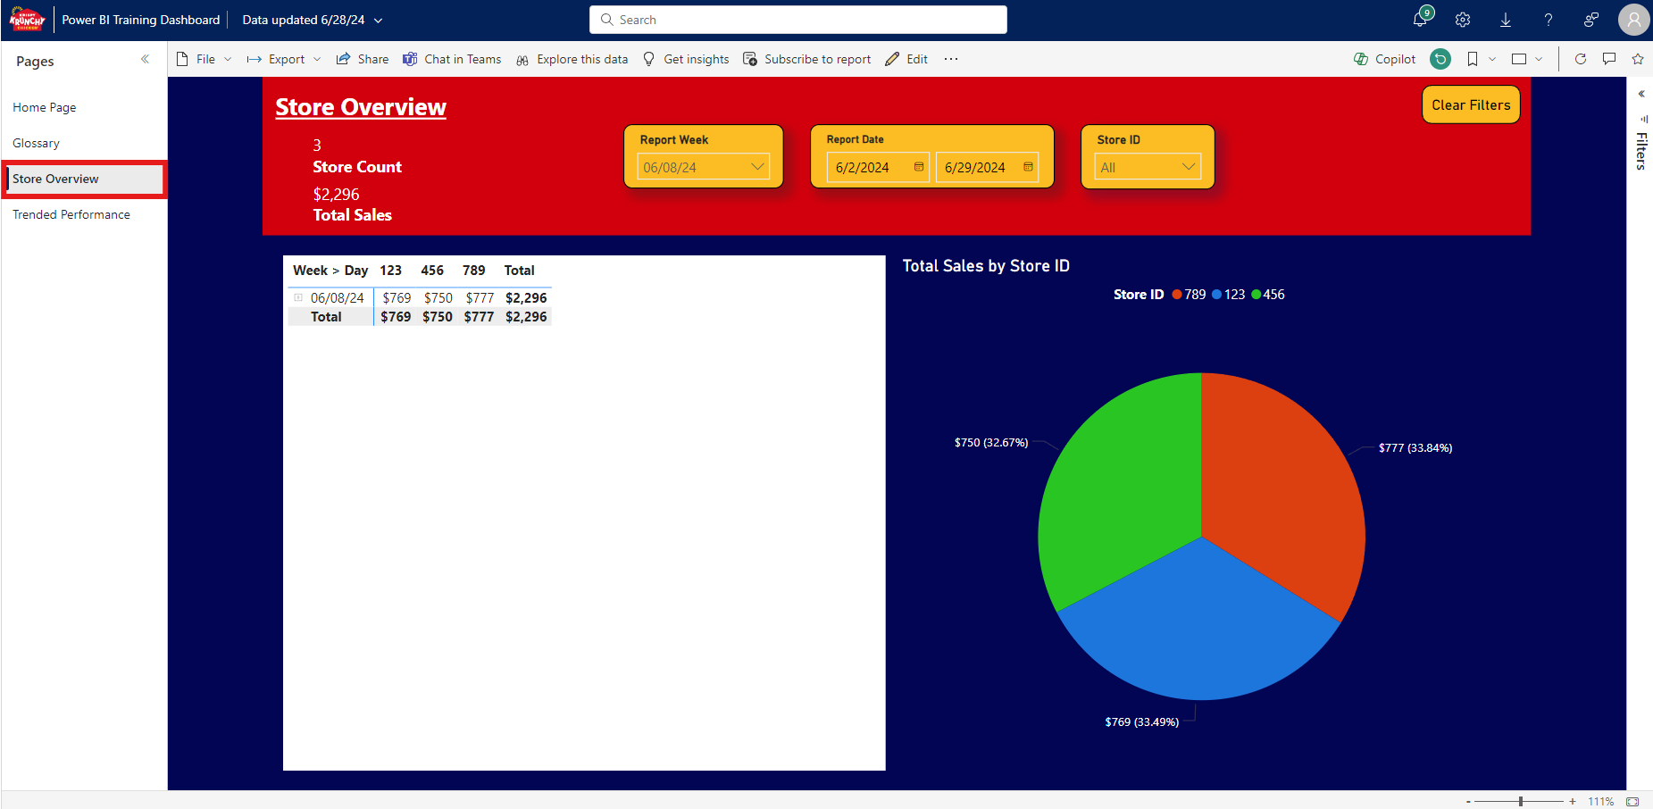
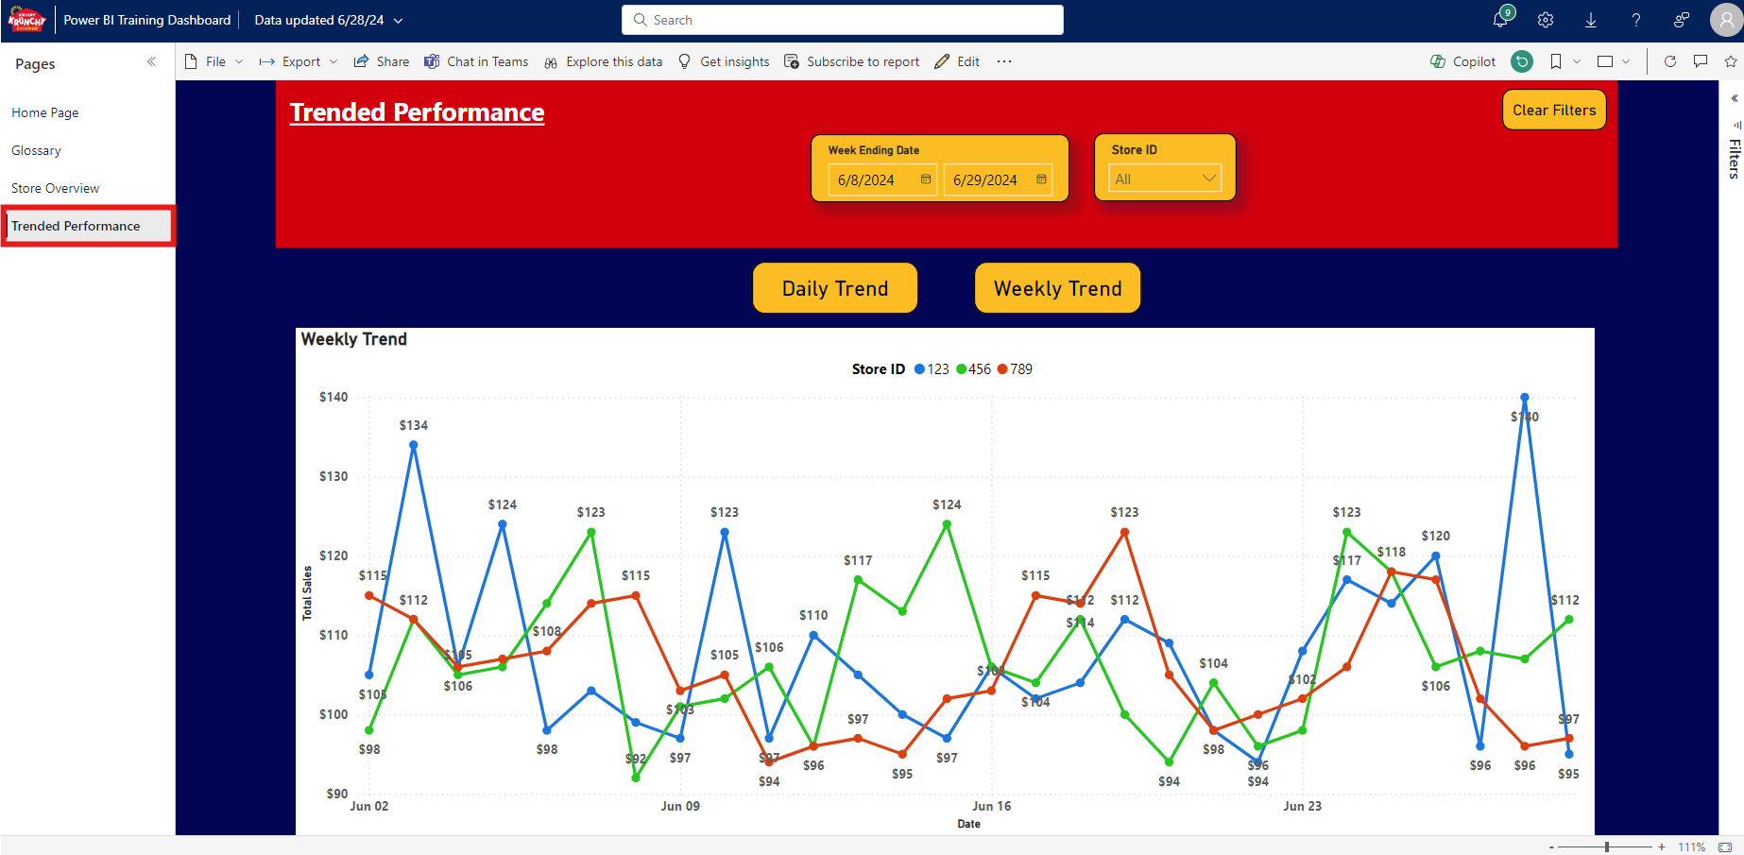
Pages Panel – Additional Pages
Additional Pages - These pages will be different depending on the dashboard and will be where users go to derive insights from the dashboard

Slide 27
How to Navigate within a Power BI Dashboard - Filters Panel

Slide 28
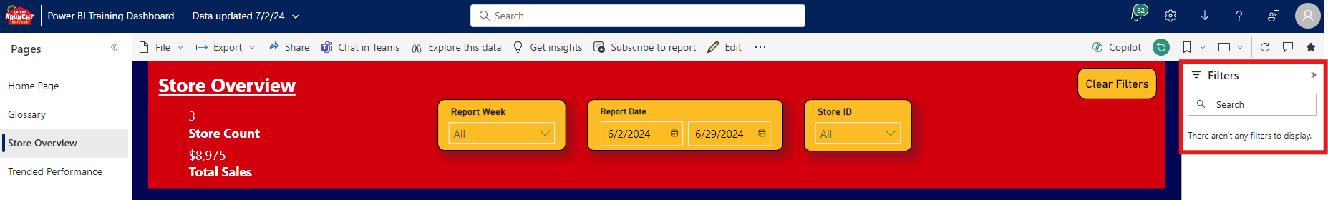
Filters Panel
Filters Panel Definition: Displays any filters that the developer(s) used when building out specific pages and/or visuals, if any
There may not be any filters used by the developer(s) for certain reports. Instead, the filtering is left up to the end-user be utilizing the slicers at the top of the page

Slide 29
How to Navigate within a Power BI Dashboard - Page Features

Slide 30
Page Features
Page Features Definition: Allow the user to interact with visuals on the page to filter the results, reaggregate the data and even decide which visuals to display and which ones to hide
Page Features:
Field Slicers / Filters
Buttons
Focus Mode
More Options
Sorting
Selecting

Slide 31
Page Features – Field Slicers / Filters
Field Slicers / Filters - Allows the user to customize the data being shown within the visuals
Video Removed To Reduce Overall File Size

Slide 32
Page Features - Buttons
Buttons: - Allow the user to clear filters or choose which visuals to display
Clear Filters - This button allows the user to clear all filters on the page to their default setting
Other Buttons - These buttons allow the user to display the visual(s) of their choosing within a single page
Video Removed To Reduce Overall File Size

Slide 33
Page Features – Focus Mode
Focus Mode - Enlarges the visual if the end user wants to hide all other visuals, or only be able to look at the 1 single visual being focused
Video Removed To Reduce Overall File Size

Slide 34
Page Features – More Options
More Options - Contains additional features that the user can use
More Options Features:
Share
Add a Comment
Export Data
Video Removed To Reduce Overall File Size

Slide 35
Page Features – More Options: Share
Share - Similar to the Share feature located in the action bar, this time the share is for the specific visual
Link to this visual - Allows the user to copy and send a link to the visual based on their sending preference
Chat in Teams - Allows the user to send a Teams chat to someone that will direct the new user to the visual within Power BI
Open in PowerPoint - Allows the user to open a PDF version of the visual
Video Removed To Reduce Overall File Size

Slide 36
Page Features – More Options: Add a Comment
Add a Comment - Allows the user to post comments on the visual within the dashboard so that other users can see
Video Removed To Reduce Overall File Size

Slide 37
Page Features – More Options: Export Data
Export Data - Allows the user to export the data within the visual
Data with Current Layout - Exports the data as it is being shown within the visual, including the filters being applied at time of export
Video Removed To Reduce Overall File Size

Slide 38
Page Features - Sorting
Sorting - Allows the user to sort columns in ascending or descending order
Video Removed To Reduce Overall File Size

Slide 39
Page Features - Selecting
Selecting - Highlights a single selection for the user to be able to focus on the selection. Also adjust other visuals on the pages based on the selection made by the user. Select the selection again to unselect and reset the visual to display all data again
Video Removed To Reduce Overall File Size

